Slide 1
Neural Networks
-Shardul Chavan
Data Science Engineering Methods and Tools

Slide 2
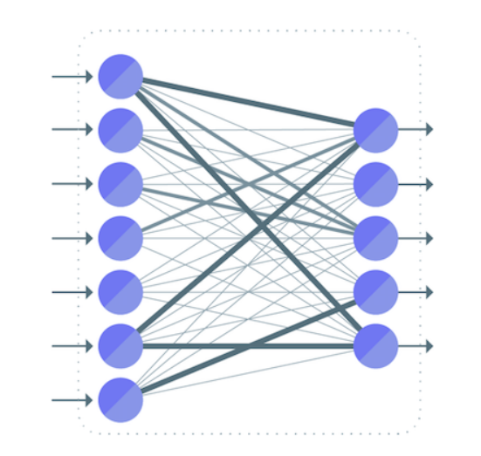
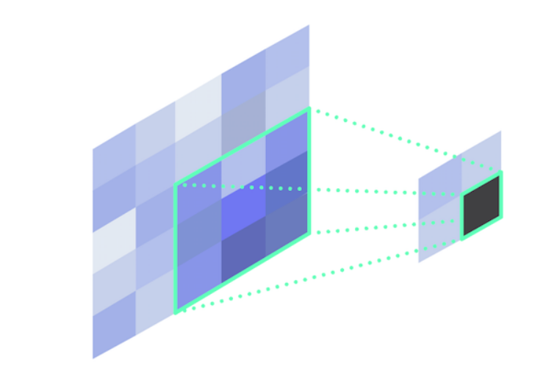
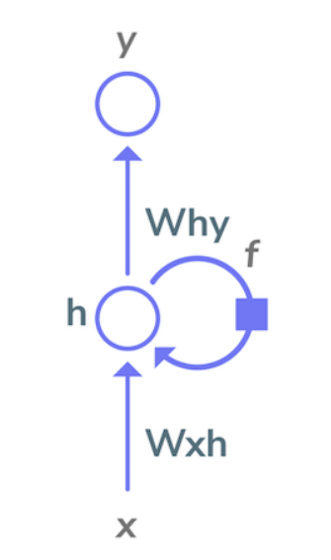
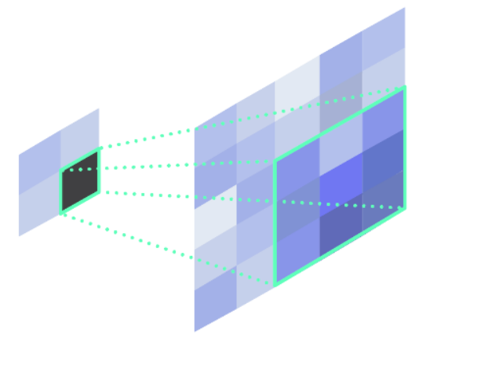
Types of Neural Networks
Fully Connected
Each neuron in one layer is connected to each neuron in another layer
Convolution
Its most common use is for detecting features in images
Deconvolution
Deconvolution layer effectively upsamples data to a higher resolution
Recurrent
Its input consists of both the data to analyze as well as the output from a previous calculation performed by that layer.

Slide 3
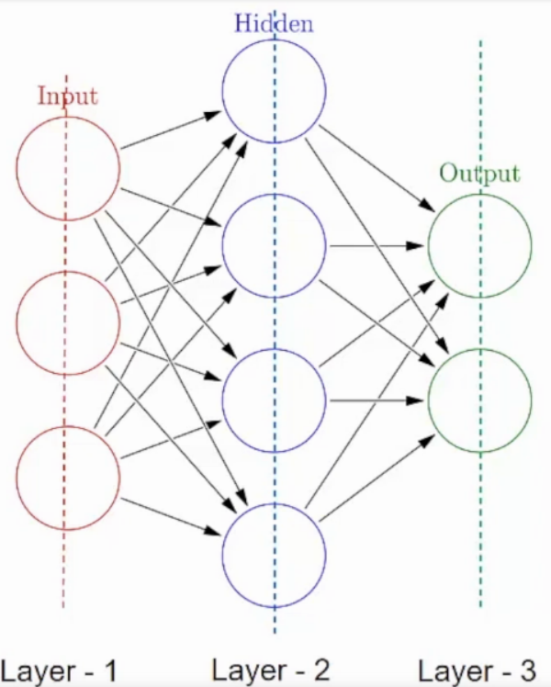
Types of Layers in Neural Networks
Input Layer
First is the input layer. This layer will accept the data and pass it to the rest of the network
Hidden Layer
Second type of layer is called the hidden layer. Hidden layers are either one or more in number for a neural network.
Responsible for the excellent performance and complexity of neural networks
Output Layer
Holds the result or the output of the problem

Slide 4
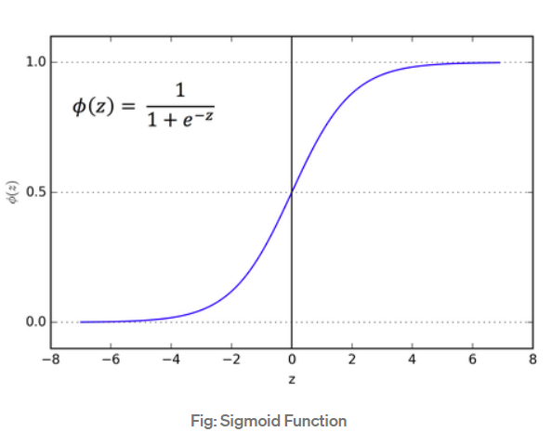
Activation Functions
It is the function through which we pass our weighed sum, in order to have a significant output, namely as a vector of probability or a 0–1 output.
Sigmoid Function
Exists between (0 to 1). Therefore, it is especially used for models where we have to predict the probability as an output

Slide 5
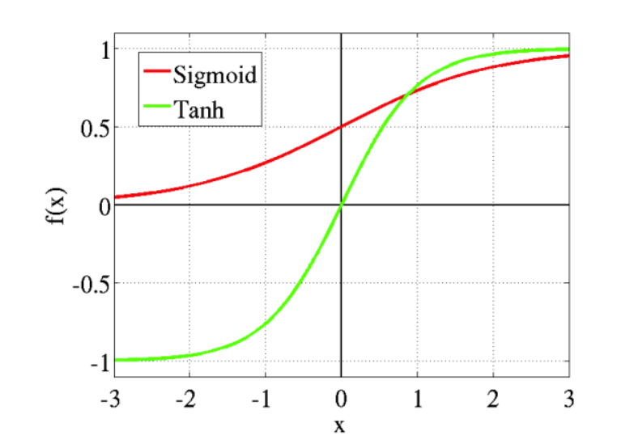
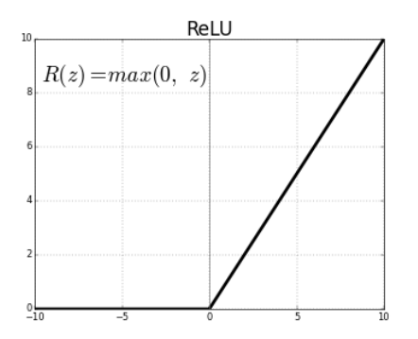
Activation Functions
Tanh or hyperbolic tangent Activation Function
tanh is also like logistic sigmoid but better
Ranges from (-1 to 1)
tanh is also sigmoidal (s - shaped)
ReLU (Rectified Linear Unit) Activation Function
Most used activation function
ReLU is half rectified (from bottom)
Ranges from 0 to infinity

